Slide 1

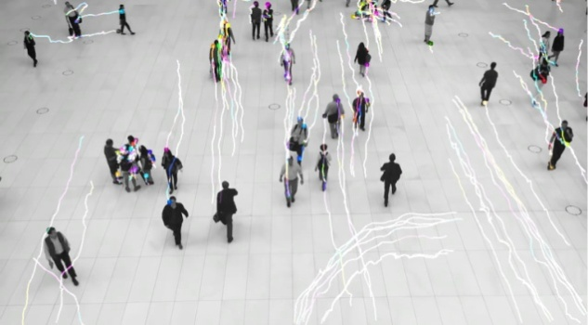
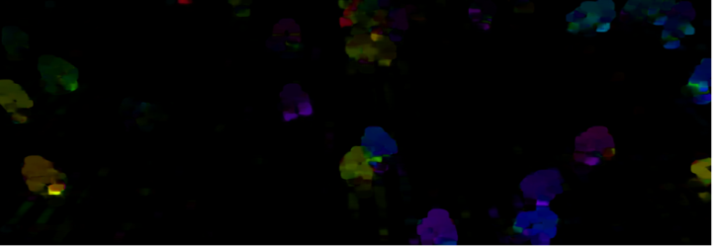
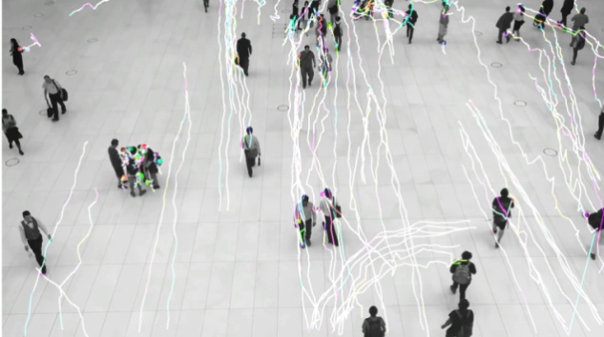
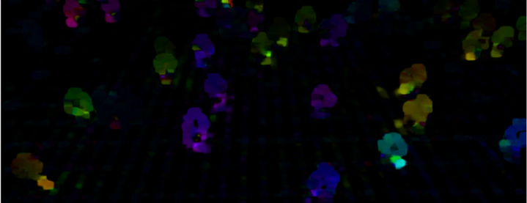
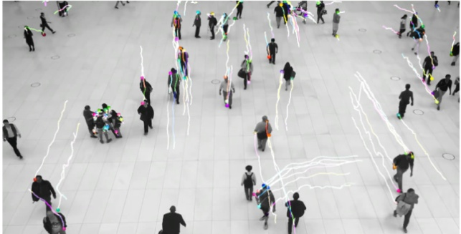
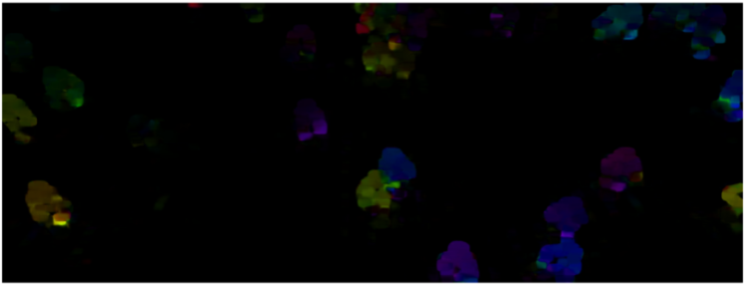
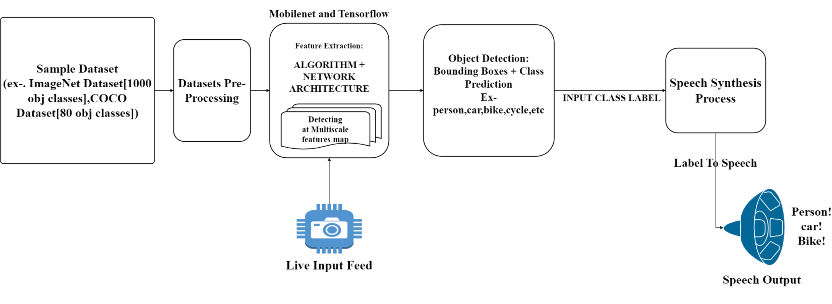
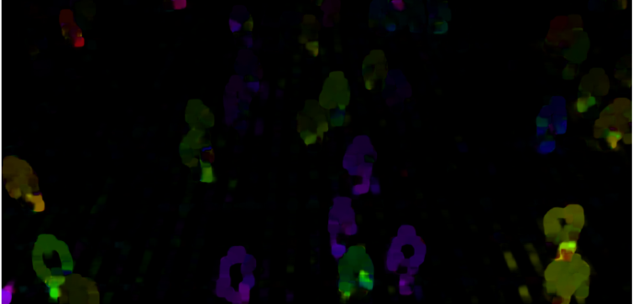
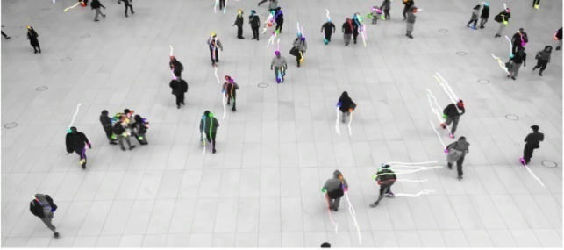
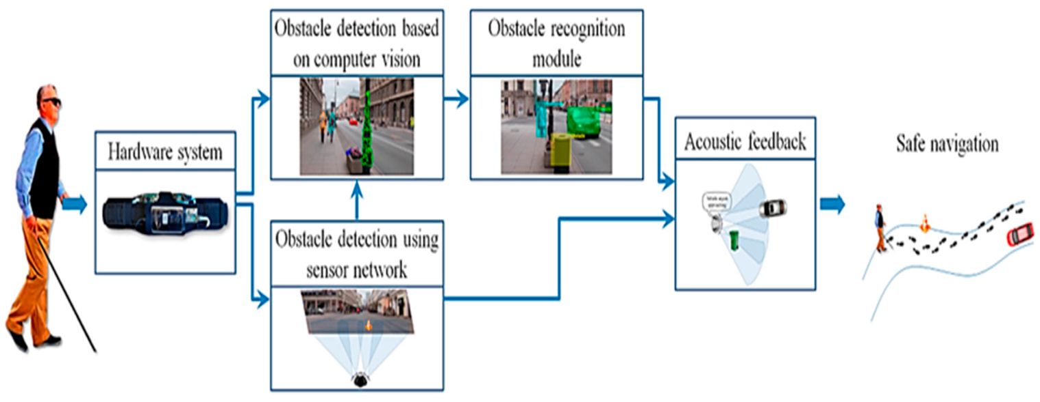
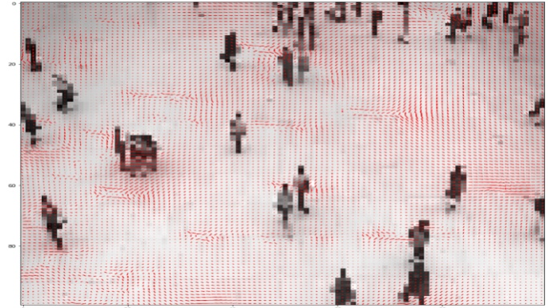
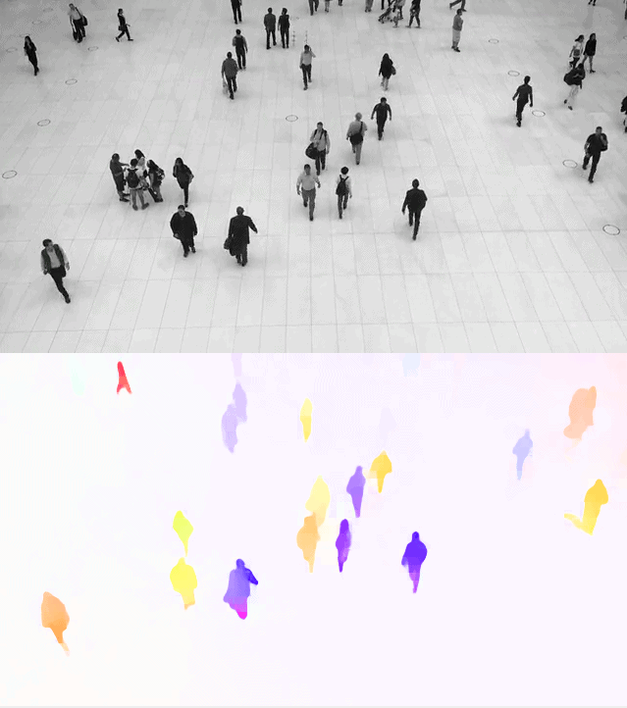
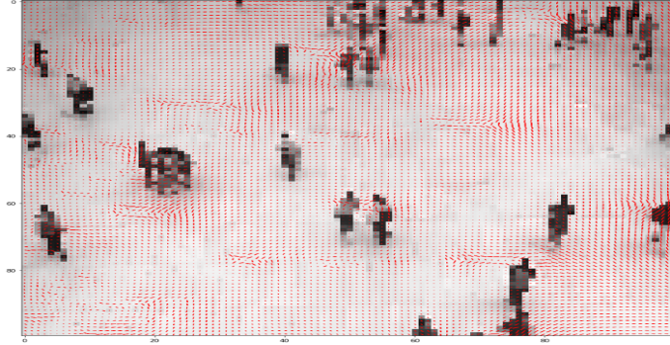
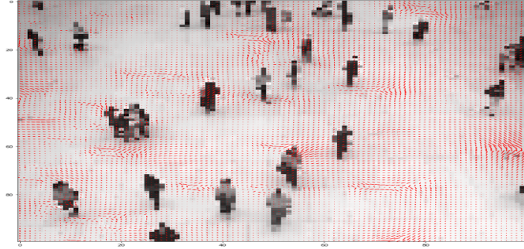
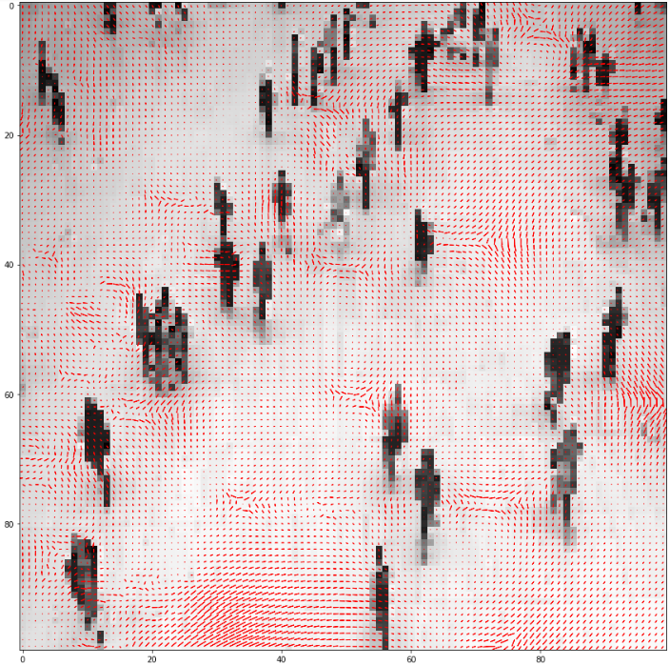
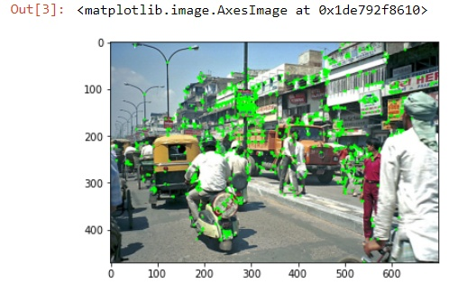
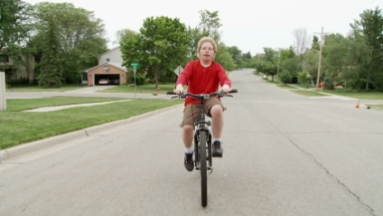
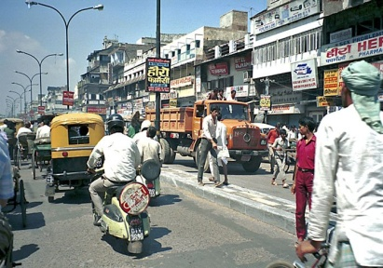
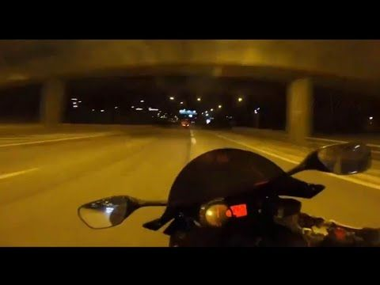
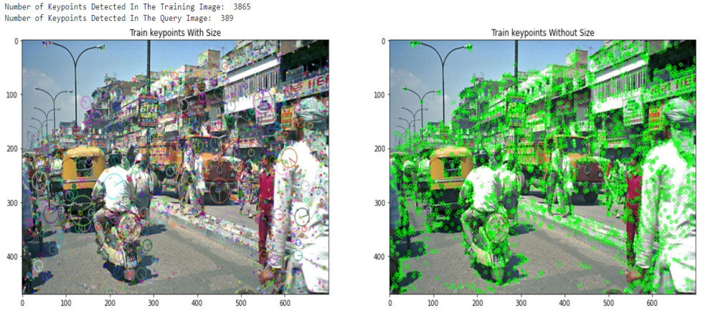
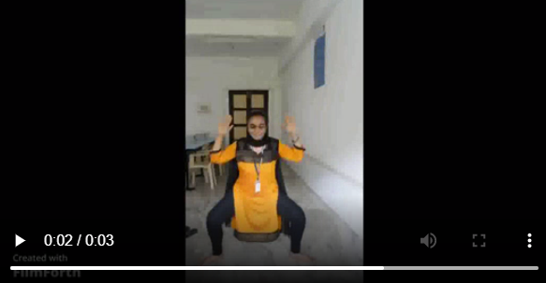
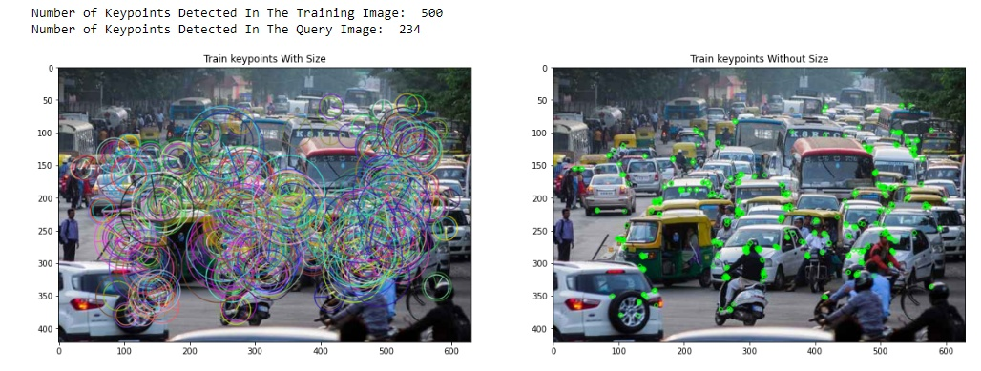
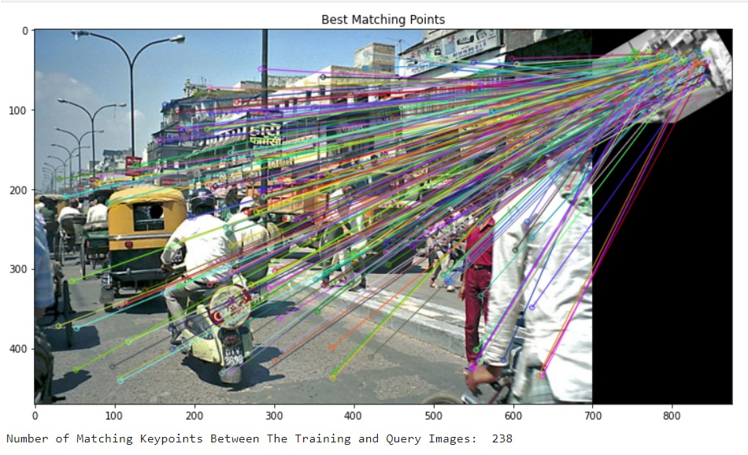
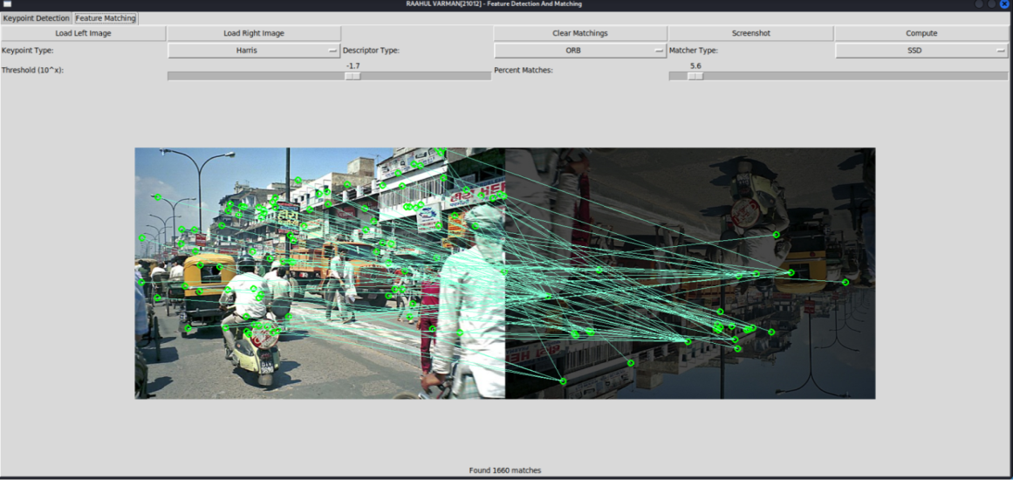
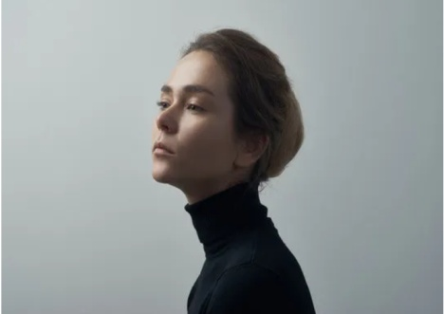
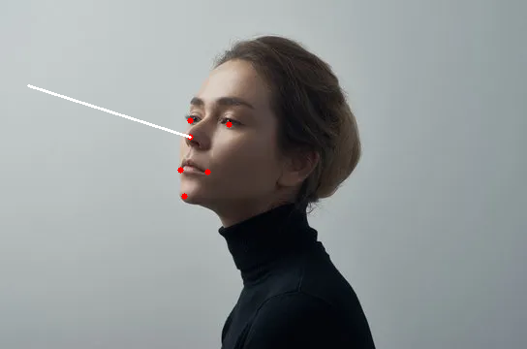
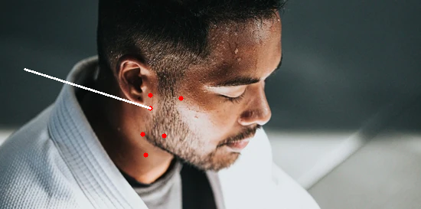
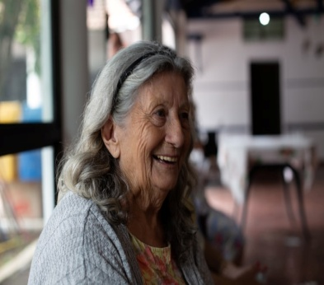
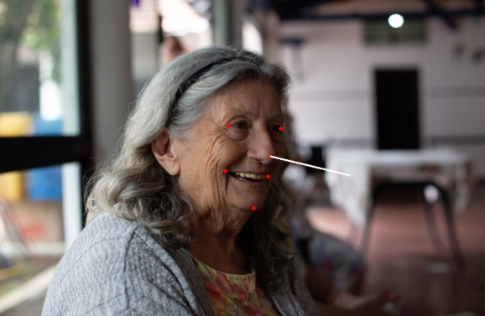
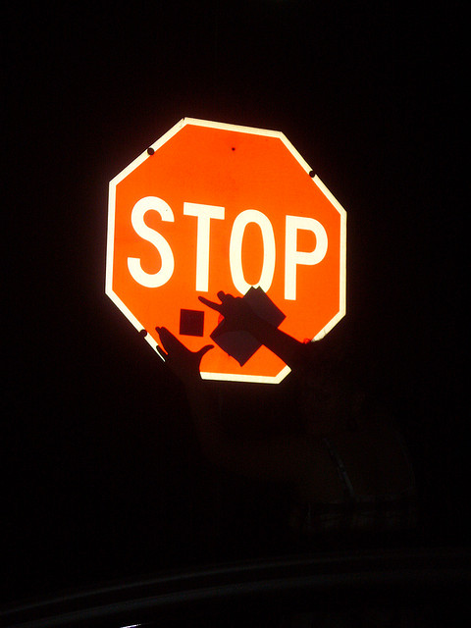
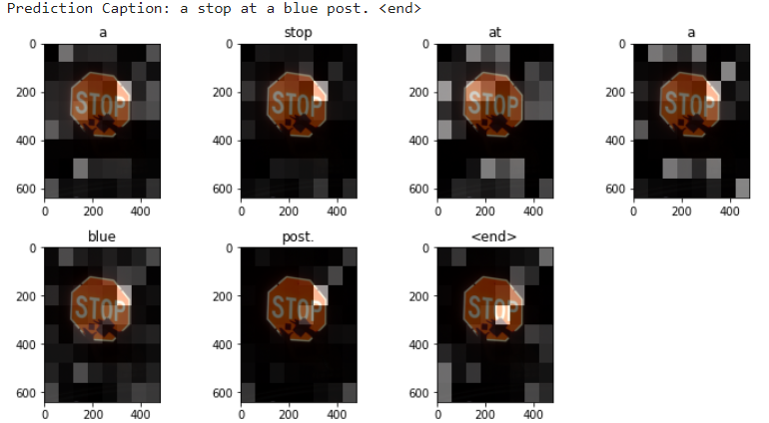
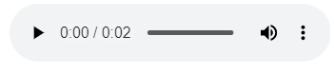
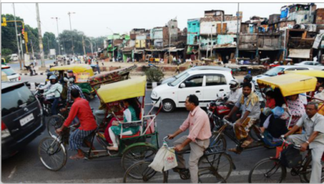
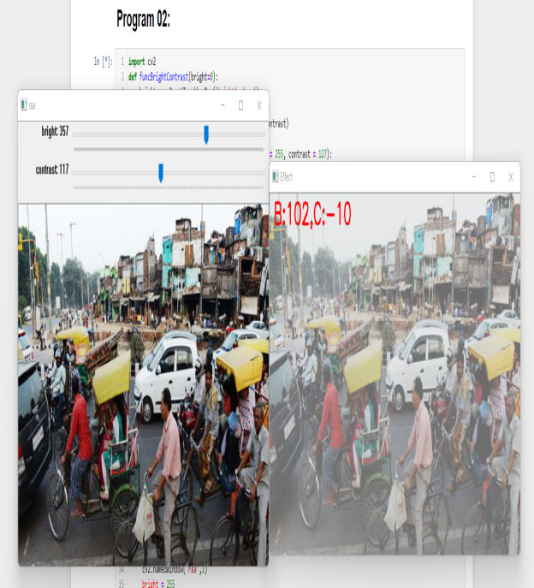
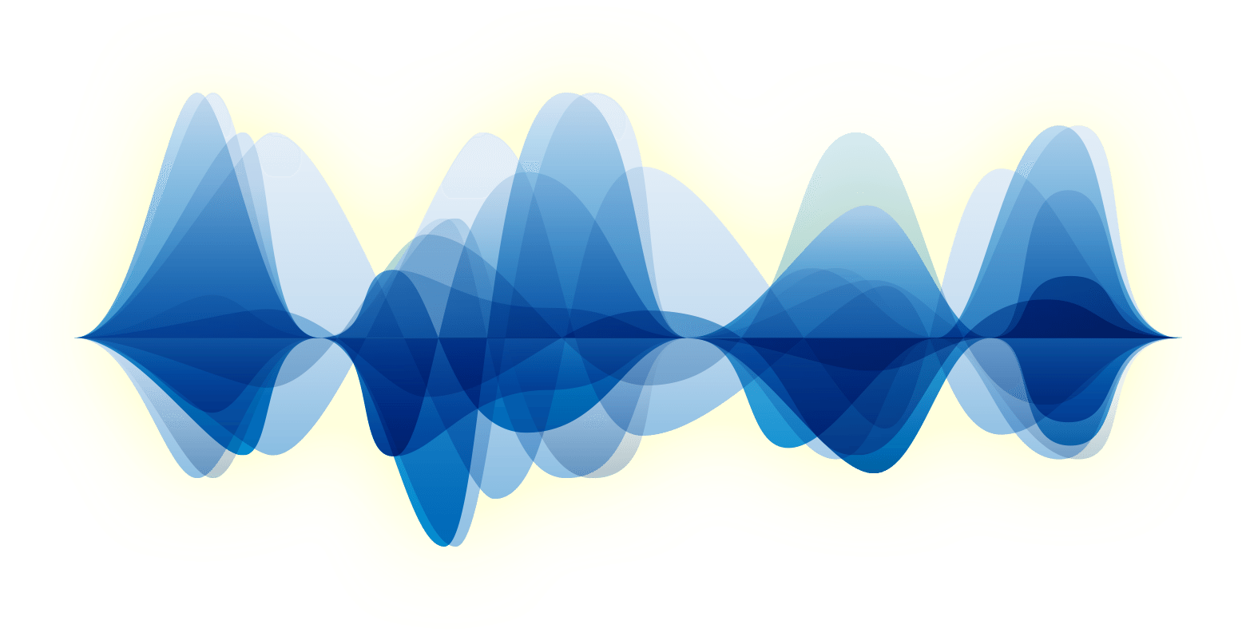
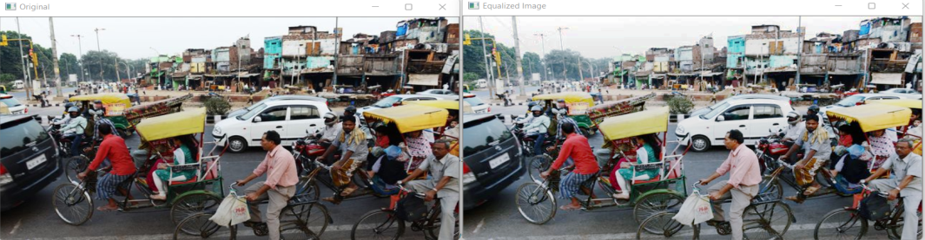
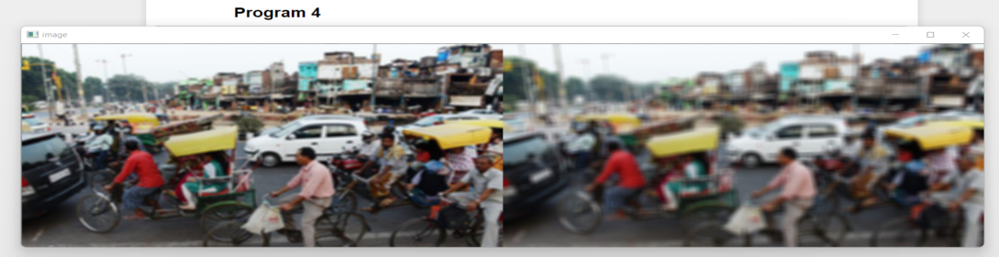
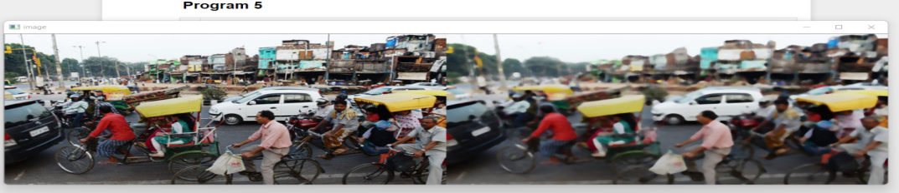
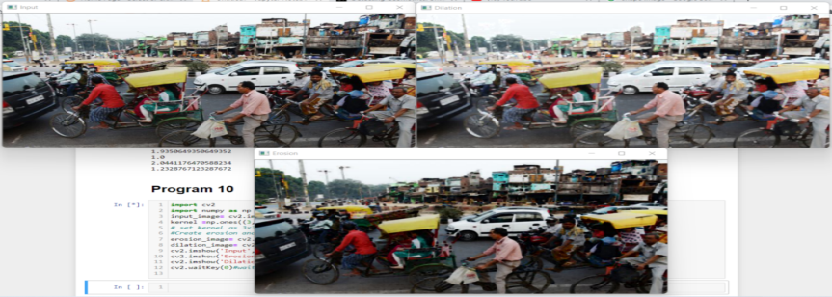
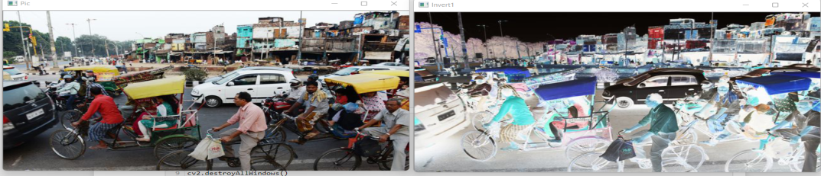
Model For Assisting Blind People By Detecting The Surrounding Objects/People/Activities With Voice Description
Raahul Varman, Suhas Preetham Kambham, Amrita University
Harris Corner Detection:
GOAL & CONTRIBUTIONS
Optical Flow Algorithm
Recently, several methods to understand CNNs through visualization have been proposed:
1. DeConvNet visualizes patterns selected by neurons [5];
2. Class saliency visualizes the "network attention” pattern [3].
However, both are heuristic and their meaning remains unclear.
Lucas Kanade Algorithm:
Dense Optical Flow algorithm
Original video |  | Time taken for original video is 3mins 41secs
Fast video |  | Time taken for fast video is 1mins 13secs
Medium video |  | Time taken for medium video is 2mins 9secs
Slow video |  | Time taken for slow video is 3mins 23secs
Inference | Lucas Kanade algorithm don’t works well in fast video footage, compare to orginal,medium and slow video footage. Algorithm was able to detect the corners and was able to estimate the where the flow could be in next image sequence.
Original video |  | Time taken for original video is 3mins 53secs
Fast video |  | Time taken for fast video is 1mins 21secs
Medium video |  | Time taken for medium video is 2mins 12secs
Slow video |  | Time taken for slow video is 3mins 47secs
Inference | Dense Optical Flow algorithm works well in fast video footage and Slow video footage, compare to orginal and medium video footage. Dense optical flow able to compute optical flow vector for each and every pixel of each frame.
Our goal is to unify, compare, and understand such techniques. We do so by:
There have been several systems designed to support visually-impaired people and to improve the quality of their lives. Unfortunately, most of these systems are limited in their capabilities. We decided to build a model which detects all possible surrounding things and guide them through voice description. Our main objective is to detect the obstacles in the person's pathway and warn them using voice description.
BLOCK DIAGRAM
Horn and Schunck:
RAFT Algorithm
Original video (Frame 137)
Fast video (Frame 35)
Medium video (Frame 71)
Slow video (Frame 50)
Inference | As the people in the video don’t have constant velocity movement the estimation in all the footage is little poor, which result in error at the boundaries.
DATASET DESCRIPTION
COCO Dataset:
https://cocodataset.org/#download
The MS COCO (Microsoft Common Objects in Context) dataset is large-scale object detection, segmentation, key-point detection, and captioning dataset. The dataset consists of 328K images with 80 classes.
The first version of the MS COCO dataset was released in 2014. It contains 164K images split into training (83K), validation (41K) and test (41K) sets. In 2015 additional test set of 81K images was released, including all the previous test images and 40K new images.
Based on feedback, in 2017 the training/validation split was changed from 83K/41K to 118K/5K. The new split uses the same images and annotations. The 2017 test set is a subset of 41K images of the 2015 test set. Additionally, the 2017 release contains a new unannotated dataset of 123K images.
Inference: Here the Optical flow is a per pixel prediction and the main idea is that it assumes a brightness constancy, meaning it tries to estimate how the pixels brightness moves across the screen over time.
Video Dataset:
BDD100K Video dataset:
https://bdd-data.berkeley.edu/portal.html#download
Dataset consists of 100,000 videos. Each video is about 40 seconds long, 720p, and 30 fps.
ACTIVITY RECOGNITION
FEATURE MATCHING
Need to identify one or more agents' activities and objectives from a sequence of observations on those actions and the surrounding circumstances.
No. | Algorithm | Input image | Output image | Principle
1. | Harris Corner Detector |  |  | Harris Corner Detector is a corner detection operator that is commonly used in computer vision algorithms to extract corners and infer features of an image.
2. | Scale-Invariant Feature Transform (SIFT) |  |  | SIFT helps locate the local features in an image, commonly known as the 'keypoints' of the image. These keypoints are scale & rotation invariant that can be used for various computer vision applications, like image matching, object detection, scene detection, etc.
3. | Oriented FAST and Rotated BRIEF (ORB) |  |  | ORB performs as well as SIFT on the task of feature detection (and is better than SURF) while being almost two orders of magnitude faster. ORB builds on the well-known FAST key-point detector and the BRIEF descriptor. Both these techniques are attractive because of their good performance and low cost.
ACTION | Sample image | Description | Output
Riding a bicycle |  | The video of a kid riding a bicycle on a road | [bicycling]
Riding motorcycle |  | The video obtained from the camera fixed o the helmet of a person riding a motorcycle. | [Biking]
Doing YOGA |  | This video obtained from the camera, a person doing yoga. | [yoga]
COMPUTER VISION BASED LIBRARY [SLOVEPNP() LIBRARY]
The PnP problem is very common in Computer Vision and stands for the Perspective n-Points problem. In this issue, we cannot determine the pose of an object with respect to the camera after being provided with the 2D and 3D coordinates.
The solvepnp() function from the OpenCV library is used for the pose estimation of a given object with respect to the camera, thus solving the PnP problem. It returns rotational and translational vectors.
Inference:
Finally, we plot a line to represent the determined pose in the image using these points.
FINAL OUTPUT
Image Pre-Processing
Filter | Input | Output |  | Inference
Brightness and Contrast |  |  |  | Contrast refers to the brightness difference between various objects or parts of an image, whereas brightness refers to the overall lightness or darkness of an image. Adding a positive constant to all of the image pixel values makes the image brighter.
Histogram Equalization |  |  |  | In image processing, a histogram is a crucial tool. It's a graphical representation of how data is distributed. An image histogram is a graphical depiction of a digital image's pixel intensity distribution. The x-axis represents the variable's possible range of values
Averaging filter |  |  |  | Average filtering is a technique for smoothing photographs by lowering the intensity fluctuation between adjacent pixels. The average filter replaces each value with the average value of neighbouring pixels, including itself, as it moves through the image pixel by pixel.
Median Filter |  |  |  | The median filter is a non-linear digital filter that is commonly used to reduce noise from images.
Erosion and Dilation |  |  |  | In an image, dilation adds pixels to object boundaries, whereas erosion removes pixels from object boundaries. The size and shape of the structuring element used to process the image determines the number of pixels added or removed from the objects in the image.
Inverting an image |  |  |  | Light areas are mapped to dark, and dark areas are mapped to light in this image processing technique.
References
B. Deepthi Jain, S. M. Thakur and K. V. Suresh, "Visual Assistance for Blind Using Image Processing," 2018 International Conference on Communication and Signal Processing (ICCSP), 2018, pp. 0499-0503, DOI: 10.1109/ICCSP.2018.8524251.
P. Vyavahare and S. Habeeb, "Assistant for Visually Impaired using Computer Vision," 2018 1st International Conference on Advanced Research in Engineering Sciences (ARES), 2018, pp. 1-7, DOI: 10.1109/ARESX.2018.8723271.
M. P. Arakeri, N. S. Keerthana, M. Madhura, A. Sankar and T. Munnavar, "Assistive Technology for the Visually Impaired Using Computer Vision," 2018 International Conference on Advances in Computing, Communications and Informatics (ICACCI), 2018, pp. 1725-1730, DOI: 10.1109/ICACCI.2018.8554625.
Y. Zheng, M. Zhang and F. Lu, "Optical Flow in the Dark," 2020 IEEE/CVF Conference on Computer Vision and Pattern Recognition (CVPR), 2020, pp. 6748-6756, DOI: 10.1109/CVPR42600.2020.00678.
Y. Zhang and F. Wang, "Improved Optical Flow Algorithm of Moving Object Detection," 2015 Fifth International Conference on Instrumentation and Measurement, Computer, Communication and Control (IMCCC), 2015, pp. 196-199, DOI: 10.1109/IMCCC.2015.48.
D. K. Liyanage and M. U. S. Perera, "Optical flow based obstacle avoidance for the visually impaired," 2012 IEEE Business, Engineering & Industrial Applications Colloquium (BEIAC), 2012, pp. 284-289, DOI: 10.1109/BEIAC.2012.6226068.
W. Tarimo, M. M.Sabra and S. Hendre, "Real-Time Deep Learning-Based Object Detection Framework," 2020 IEEE Symposium Series on Computational Intelligence (SSCI), 2020, pp. 1829-1836, DOI: 10.1109/SSCI47803.2020.9308493.
G. Chandan, A. Jain, H. Jain and Mohana, "Real Time Object Detection and Tracking Using Deep Learning and OpenCV," 2018 International Conference on Inventive Research in Computing Applications (ICIRCA), 2018, pp. 1305-1308, DOI: 10.1109/ICIRCA.2018.8597266.

